Slide 1


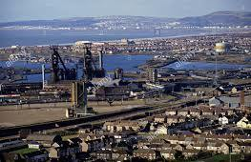

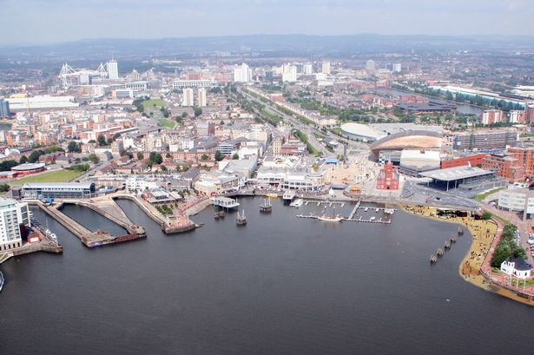
An introduction to City Region and Growth Deals in the Devolved Administrations.

Slide 2
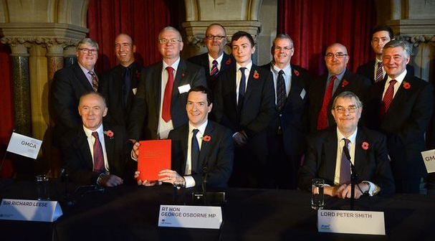
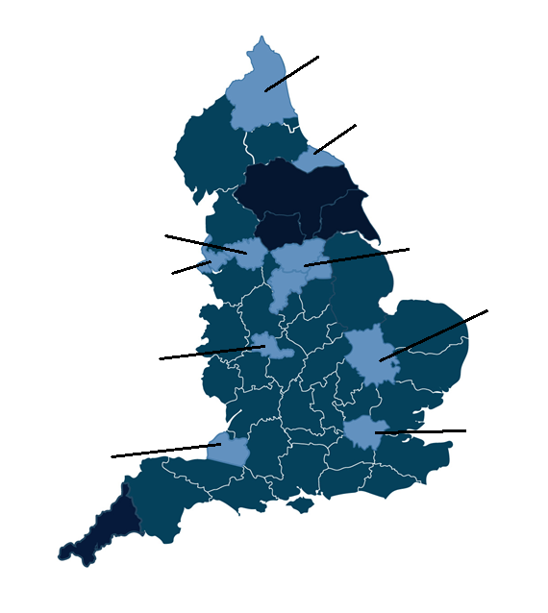
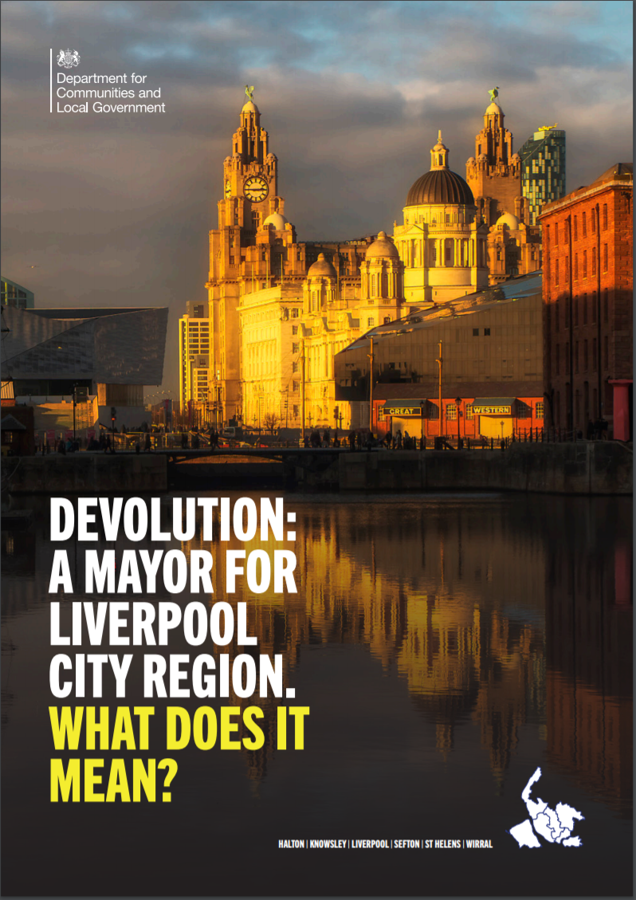
Devolution and Decentralisation agenda since 2010
North of Tyne
Tees Valley
Greater
Manchester
Sheffield City
Region
Liverpool City
Region
Cambridge &
Peterborough
West Midlands
Greater London
West of
England
2010
2011
2012
2013
2014
2015
2016
2017
2018
2019
Growth Deals totalling £9.1 billion agreed with all LEPs
Devolution deals and city mayors
Local Enterprise Partnerships established
City Deals agreed with 28 places across England
City Deals extended into Scotland, Wales and Northern Ireland.
Local Industrial Strategies – WM and GM

Slide 3
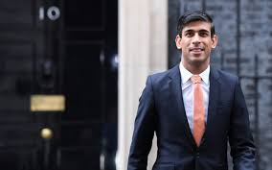
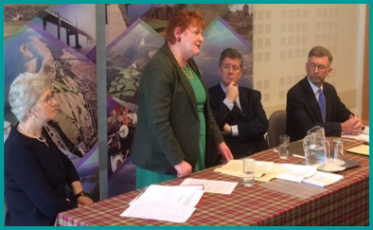
DA Deal Making Process
Quantum Announced
Local partners develop proposition
HMG Warm Words
Invitation to submit proposals
Policy workshops
to discuss and develop proposals
Proposals submitted
and negotiation start
Heads of Terms
goes public once agreement ‘in principle’ reached
Business case sign off
by policy officials and DA governments
Full Deal Document
goes public confirming deal contents
Implement Projects
and on going assurance
Partnership and Investment
Ensure strong local / private sector part’ship and invest’nt
Stage 1: Invitation
Stage two: Development of proposals including policy input and expertise
(C&LGU, local partners, the Devolved Administration and the Territorial Office)
Stage 3: Finalise deal package and WH write round
Stage 4: Approve business cases and release funding
Timescales - Depend on (1) Quality of the proposals and (2) Political appetite

Slide 4
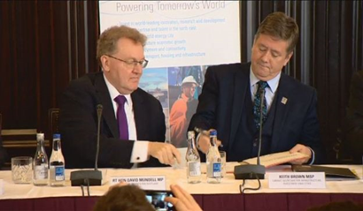
What DA City and Growth Deals are
UK Government Priorities
Levelling-up Agenda.
Build Back Better: our plan for growth.
Principles
The deals are:
bottom up - based on local (agreed) priorities and proposals.
jointly agreed with the devolved governments.
should lever in investment
The deals are not about devolution of powers or governance change.
Headlines
Deals are tri-partite agreements between the UK Government and the Governments of Scotland, Wales or Northern Ireland; and local authorities, to coordinate investment in strategic projects that will drive economic growth in priority sectors for the region.
Each Deal brings together local leaders and key stakeholders, including businesses, universities and the third sector, to coordinate public and private investment.
Investment priorities through current deals tend to be in digital infrastructure, sector innovation, transport connectivity, tourism and culture, business growth, place and regeneration.
Scope
UKG deal commitments are:
(generally) related to reserved policy areas (including digital infrastructure, innovation, energy)
limited to capital funding over a longer term (10-15 years) flat profile.
subject to business case (HMT Green Book standard).

Slide 5
DA Deals Agreed to Date
There are 20 City and Growth Deals agreed and in negotiation, committing more than £3bn of UK Government investment.
Working with local partners and the Scottish, Welsh and Northern Irish governments 17 deals have been agreed to date in devolved administrations.
3 are currently being negotiated but have not yet reached Heads of Terms stage
Deals agreed | UKG Funding
Glasgow City Region | £523.67m
Aberdeen City Region | £125m
Inverness and The Highlands | £53m
Edinburgh and South East Scotland | £300m
Stirling and Clackmannanshire | £45.1m
Tay Cities | £150m
Ayrshire | £103m
Borderlands | £265m
Cardiff City Region | £500m
Swansea Bay | £115m
Belfast City Region | £350m
North Wales | £120m
Moray | £32.5m
Argyll and Bute | £25m
The Islands | £50m
Mid Wales | £55m
Derry City and Strabane | £105m
Deals planned | Funding Allocated
Falkirk | £40m
Mid South West Northern Ireland | £126m
Causeway Coast and Glens | £36m

Slide 6




Desired DA Deal Outcomes
Growth Shared Fairly.
Build Strong Self-sustaining Partnerships.
Government funding for Deals to catalyse growth and other investment to continue it.
Effective Deal Delivery.

